Slide 1

The atomic advantage: Isolation & Control
Laser cooled atoms trapped by light in vacuum.
Superb quantum memory with coherence from seconds to minutes.
Selective control using laser pulses
Excitation of Rydberg state provides super-strong interactions and fast logic operations at tens of nsec.
Superstrong interaction
in nanoseconds
Rydberg
atoms
Laser pulse
on/off ratio 10¹²
Neutral atoms trapped by light
Quantum properties maintained for seconds to minutes.

Slide 2
Which atom should we pick ?
Periodic table of laser cooling
Single atom arrays:
Rb, Cs
Sr, Yb

Slide 3
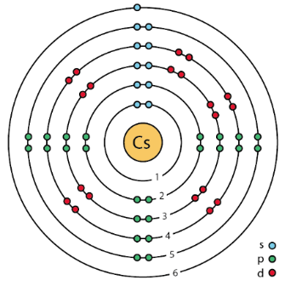
An industry standard qubit
Cesium
f=4
|1>
S=7/2
9,192,631,770 Hz
s=1/2
|0>
f=3
The hyperfine m=0 clock states
provide the SI definition of the second.
These states are entangled superpositions of nuclear and electronic spin projections
Excellent coherence properties:
In free space hyperfine lifetime 34 years
When optically trapped T1, T2 up to 10s has been demonstrated
Coherence limited by finite atom temperature, trap light optical Stark shifts, magnetic fields.
Minute scale coherence appears possible.
|1>= +
|0>= -

Slide 4
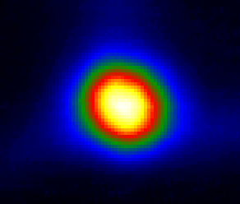
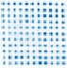
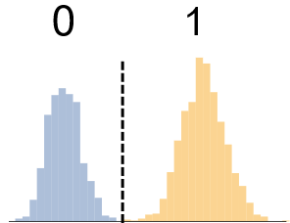
Operational Sequence
Qubit Register Preparation
Calculation Cycle
Cold
Atoms
Single Atom
Array
Filled
Array
State
Initialization
Quantum
Circuit
Measure
Results
f=4
|1>
Cesium
f=3
|0>
Camera
Camera
Camera
Optical Pumping
895 nm laser
Gates
1Q, 2Q
459 nm, 1040 nm lasers, μwaves
Laser cooling
852,894 nm lasers
Array
825 nm lasers,
Deep cooling
Rearrange-ment
1064 nm
laser
852 nm lasers
Controlling the Mechanics
Controlling the Quantum

Slide 5
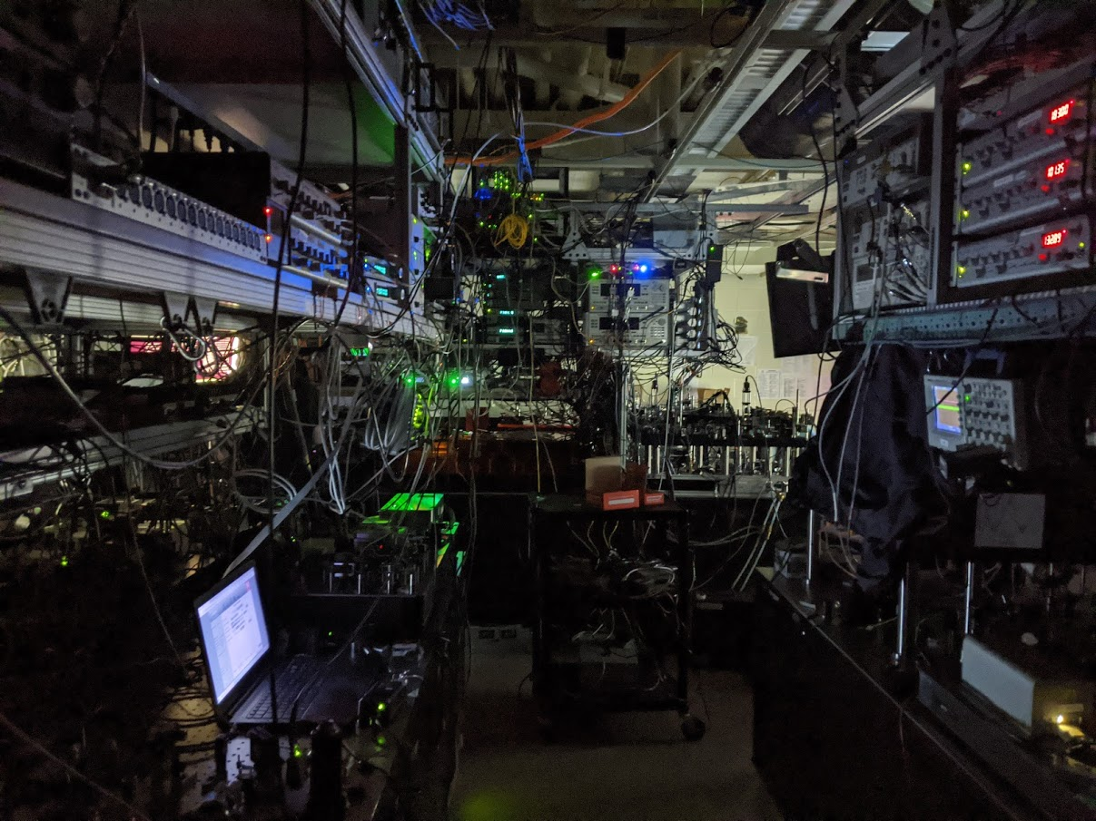
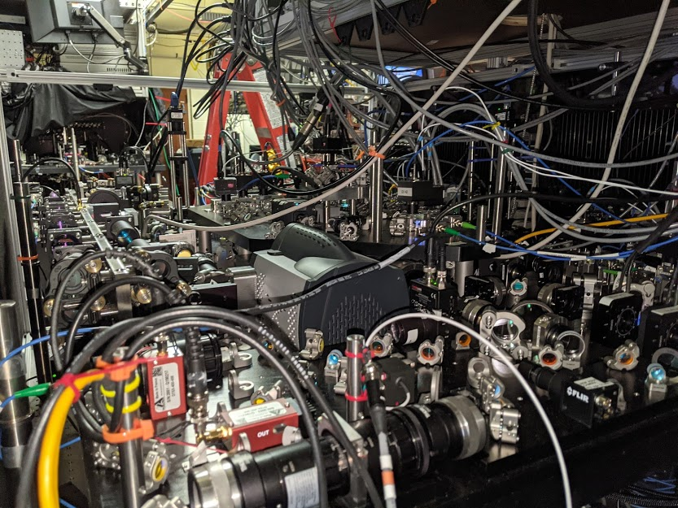
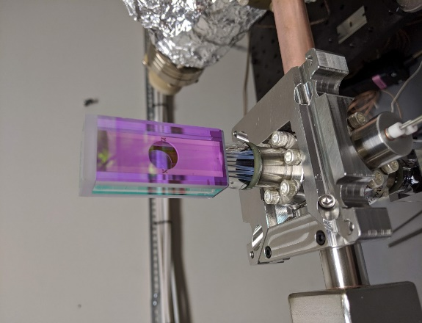


Slide 6
Experimental geometry

Slide 7
Gate set
Cs
f=4
Encode in Cs clock states:
Universal gate set:
Global gates
microwaves
Single site gates
microwaves+optical
Stark shift
|1>
9.2 GHz
f=3
|0>
m_{f}=0
Bias field of 1.5 G
Rydberg gate
Angle φ in x-y plane
from μwave phase
i,j site indices or more
Rydberg gate & local rotations
Native multi-qubit gates are also possible: (CNOT)^{k}, C_{k}NOT.
Harvard Toffoli demonstration.

Slide 8
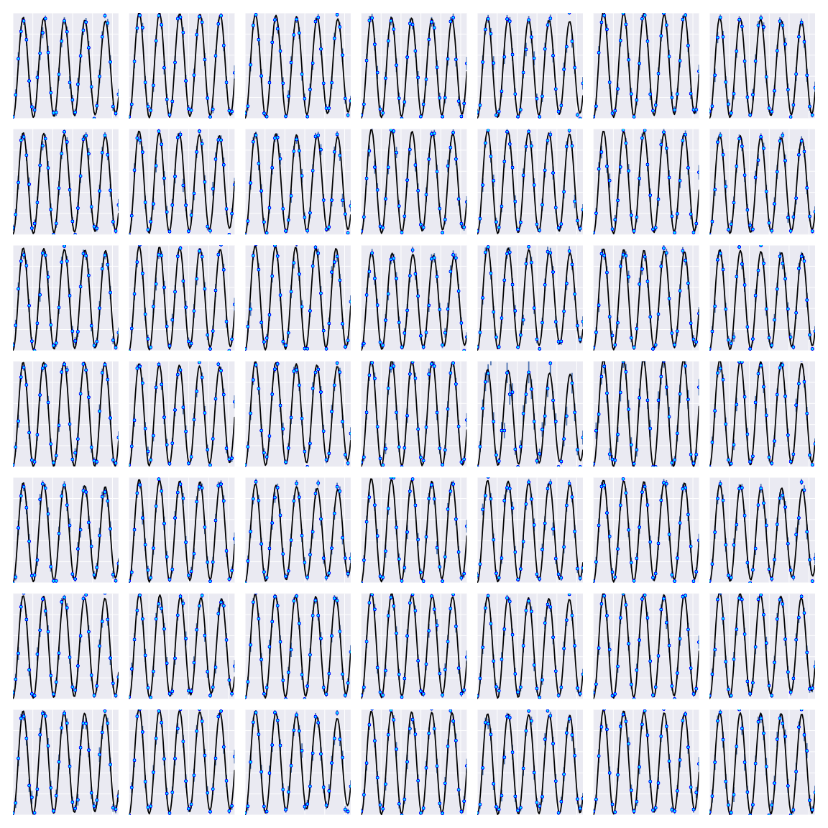
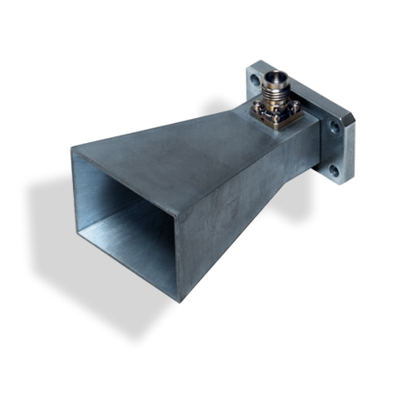
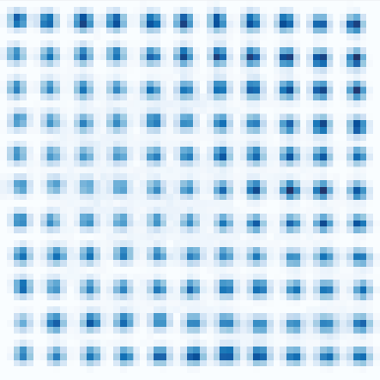
Single qubit gates - global
PRL 114, 100503 (2015)
Cs clock state qubits
Microwaves 10 kHz Rabi frequency
f=4
|1>
9.2 GHz
f=3
|0>
m_{f}=0
Bias field of 1.5 G

Slide 9
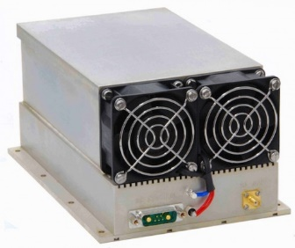
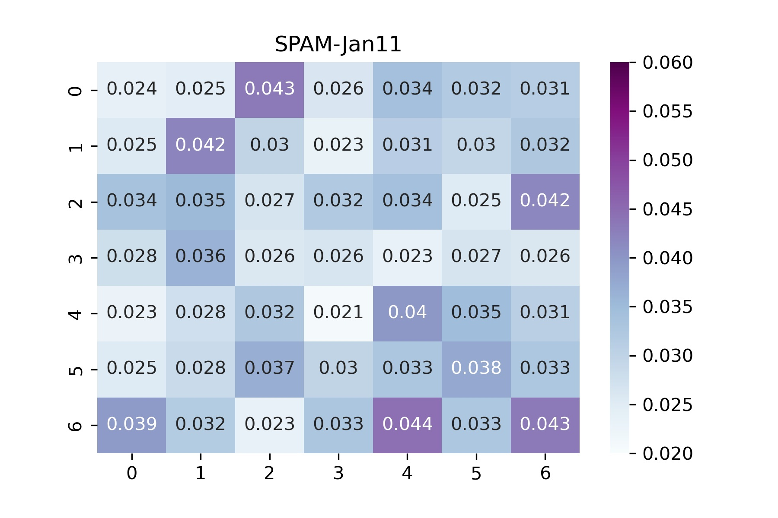
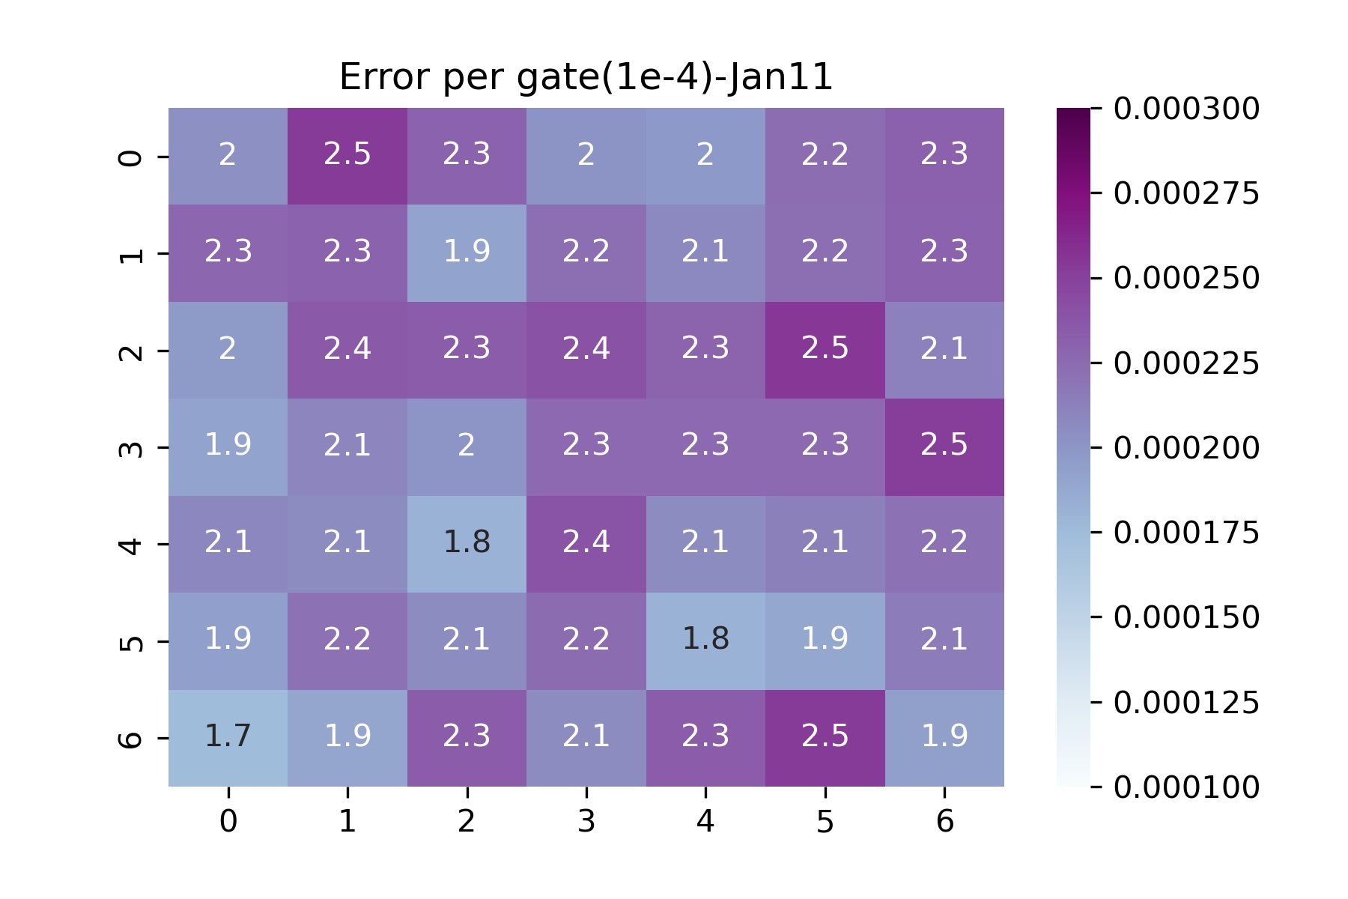
Single qubit gates – global Randomized Bencharking
SPAM 49 sites
Average error=0.031
Extracted from microwave RB
Microwave Clifford Gates
49 sites
average F=0.9998
Microwaves 76 kHz Rabi frequency

Slide 10
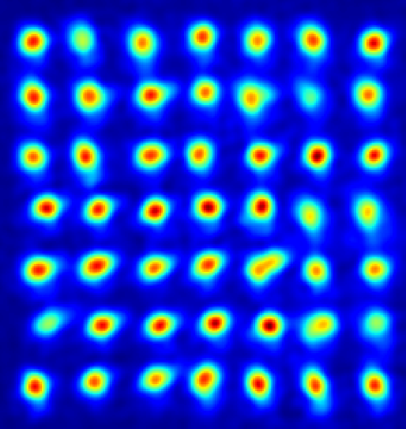
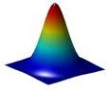
Single qubit site selected gates
A R_{z}(θ) gate is obtained with a focused Stark shift laser.
δ₁
δ₀
1
0

Slide 11

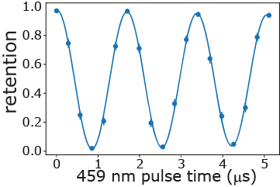
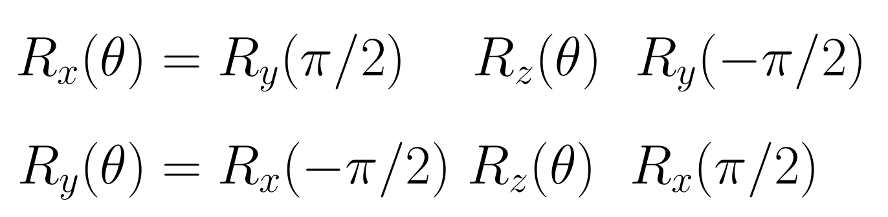
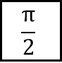
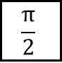
Single qubit site selected gates
A R_{z}(θ) gate is obtained with a focused Stark shift laser.
We use the 459 nm Rydberg laser.
Site selected R_{x}(θ), R_{y}(θ) are obtained by combining with global rotations.
μwave
459 pulse
μwave
δ₁
$$\frac{π}{2}$$
$$\frac{π}{2}$$
δ₀
t
1
0
global
Weiss group
Science (2016)
Site
selected

Slide 12
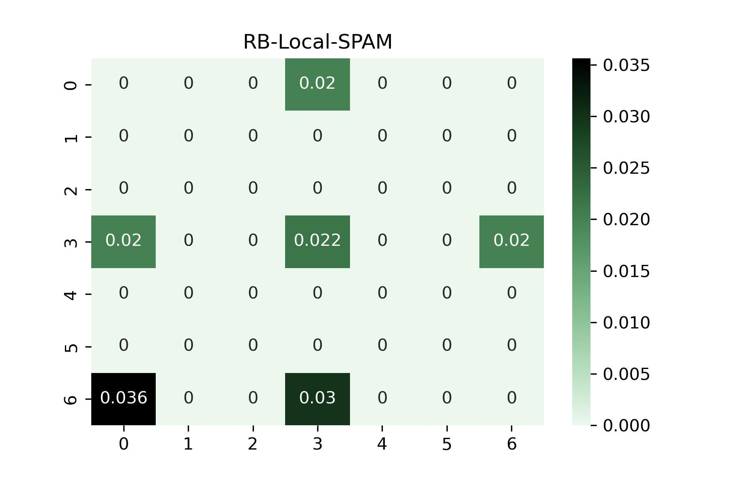
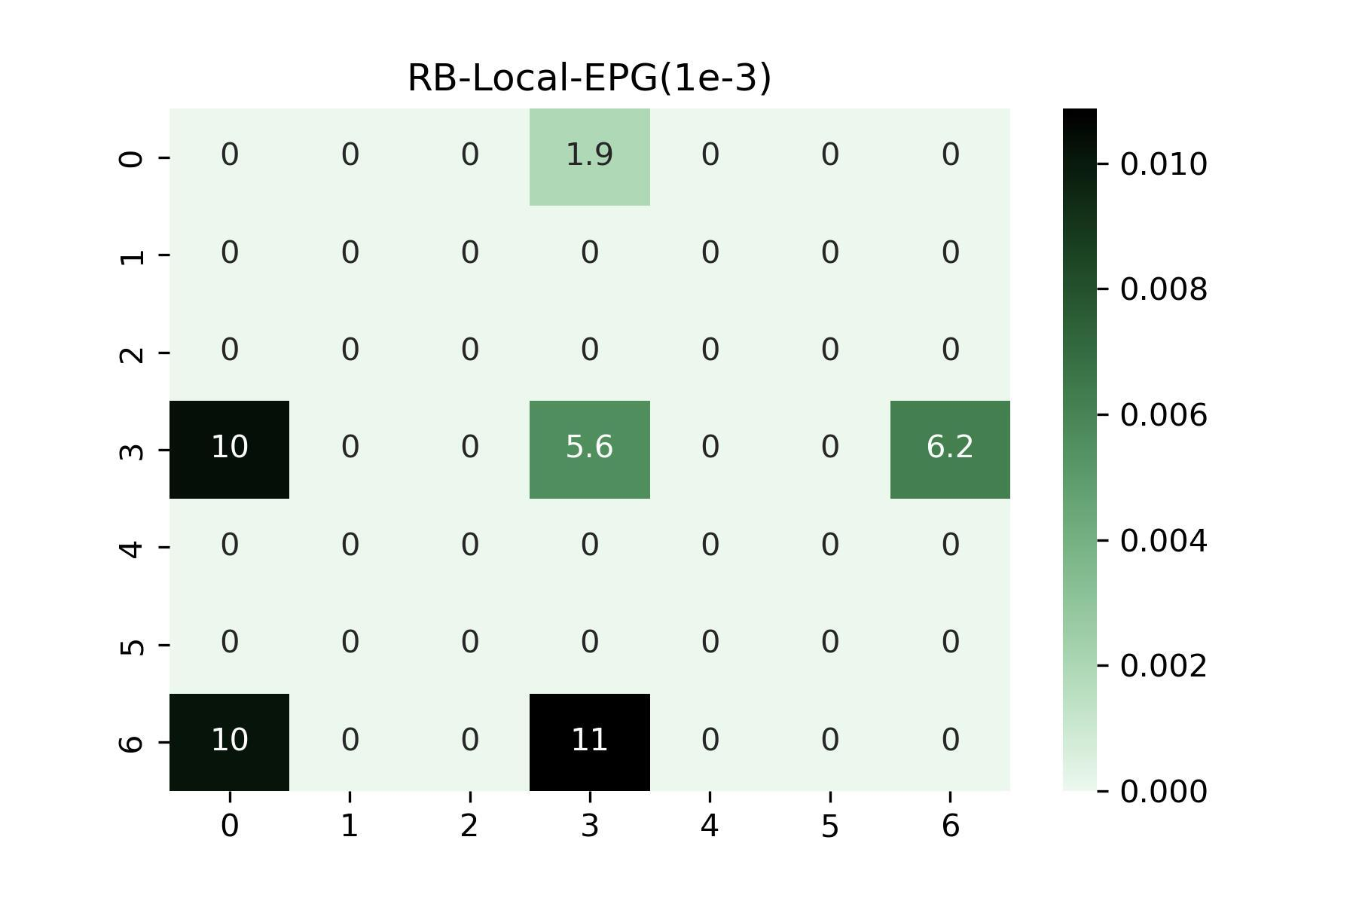
Single qubit gates – local Randomized Bencharking
SPAM 6 sites
Average error=0.025
Extracted from local RB
Local gates 6 sites
average F=0.993

Slide 13
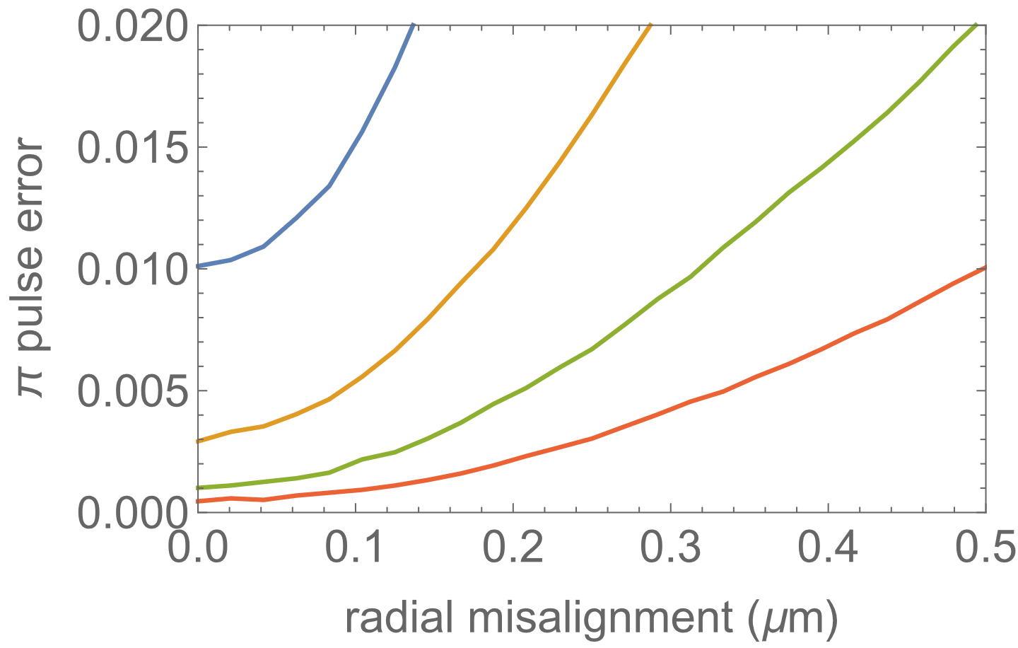

Optical addressing
Focused Gaussian control beams with w=3 μm
Very sensitive to alignment
Beam shaping reduces sensitivity
w=2 μm
3 μm
4 μm
Simulated Rz error
5 μm
T=5 μK
Measured beam position jitter
σ=20 nm

Slide 14
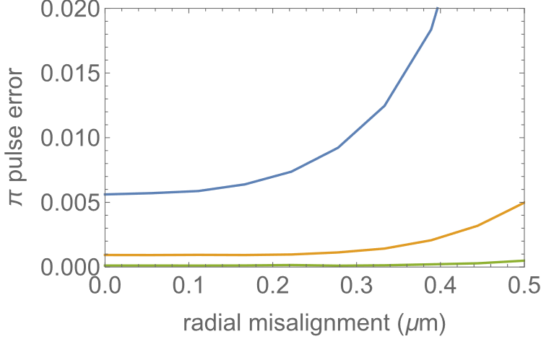
Optical addressing
Simulated Rz error
Line array: T= 5 μK, 500 μK traps, d=3 um, s=3, λ=825 nm
Gaussian beam
Super Gaussian ρ⁶
w=2 μm
3 μm
4 μm
w=1 μm
5 μm
1.5 μm
2 μm

Slide 15
2Q gate fidelity
Rydberg 75s state
Small beams w=3 μm
for individual qubit
addressing
Used protocol from Levine, et al. (2019) with parameters adjusted for both strong and weak blockade.
SPAM corrected Bell fidelity F~0.955.
B/2π=1.0 GHz
B/2π=3.0 MHz

Slide 16
Quantum circuits with neutral atom qubits
Stationary control beams / moving atoms
Moving control beams / stationary atoms
Harvard/MIT
Nature 604, 451 (2022)
Wisconsin/ColdQuanta
Nature 604, 457 (2022)

Slide 17
GHZ states
A good test of circuit operation is preparation of entangled GHZ states

Slide 18
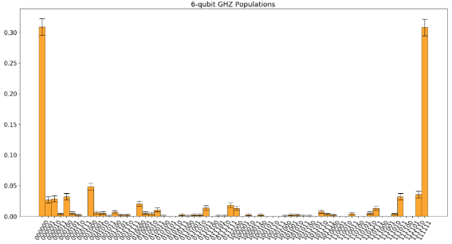
GHZ states
N=6
uncorrelated
non-Markovian
motion
Collective
non-Markovian
B-field, laser intensity

Slide 19
Phase estimation
Quantum phase estimation is one of the most important quantum algorithms. Useful for quantum chemistry and factoring.

Slide 20
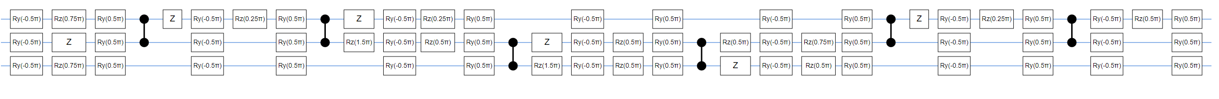
Phase estimation
Test for measuring phases of 0, π/2, π, 3π/2
Output register

Slide 21
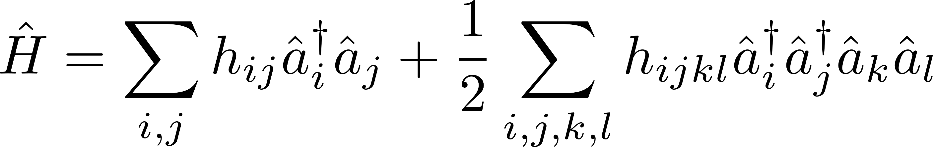
Quantum phase estimation – Hydrogen molecular energy
Hydrogen molecular Hamiltonian
qubit encoding
2-qubit Hamiltonian
P. J. J. O'Malley et al., Phys. Rev. X 6, 031007 (2016)
symmetry
1-qubit Hamiltonian
4 electronic orbitals
S. Bravyi et al., arXiv:1701.08213
1st order Trotterization

Slide 22
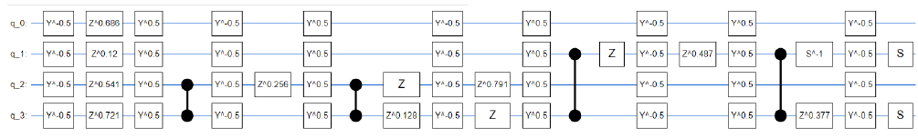
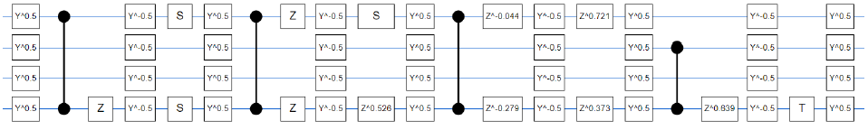
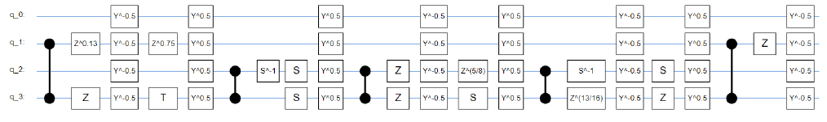
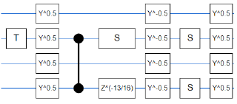
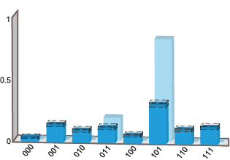
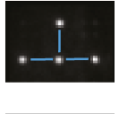
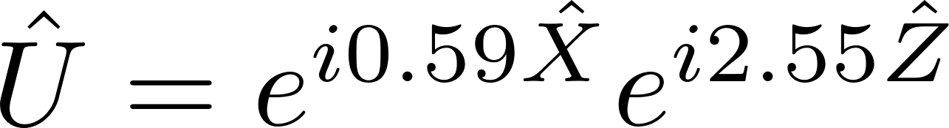
Quantum phase estimation – Hydrogen molecular energy
Circuit
1.1 ms execution time, circuit depth of 57 1Q gates and 14 2Q gates
Experiment
measurement qubits
well-resolved
ground energy
E_{g} = -1.06 Ha
state qubit

Slide 23
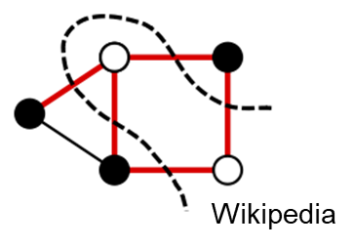
QAOA MaxCut
NP-complete graph partioning problem.
QAOA applies p rounds of cost function and
mixing operators with adjustable weights.
p=3 circuit
43 single qubit
gates
18 CZ gates
1 2 3
Ideal circuit: R_{a} = 0.772 0.934 1.0

Slide 24
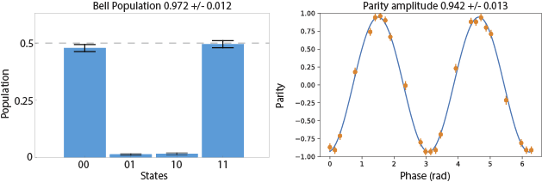
Rydberg entanglement experiments
 | Wisconsin | Harvard | Wuhan | Caltech
Architecture | 2D array, blue traps, focused beams | 2D array, red traps, large beams | 2D array red traps, medium size beams | 1D array, red traps, large beams
Atom | Cs | 87Rb | 87Rb | Sr
2Q Bell state fidelity Raw (-SPAM) | 0.955 (>0.965) | 0.95 (0.97) | 0.95 (0.98) | 0.98(0.991)
Notes | Ti:Sa lasers “Pichler” 2-pulse protocol | Ti:Sa lasers “Pichler” 2-pulse protocol | Filtered diode lasers Adiabatic 1-pulse protocol | Ground-Rydberg qubit, short lived
Papers | Nature 604, 457 (2022) | Nature 604, 451 (2022) | https://arxiv.org/abs/2109.02491 PRA 103, 022424 (2021) | Nat. Phys. 16, 857 (2020)
F_{raw}=0.955
F_{-SPAM}>0.965

Slide 25
Qubit control
2Q gates
ns_{1/2}
m=-1/2 +1/2
1038 nm
1Q gates
7p_{1/2}
459 nm
cooling,
readout
6p_{3/2}
cooling,
optical
pumping
6p_{1/2}
1.2 GHz
1064 nm rearrangement
852 nm
825 nm, trapping
6 different colors
13 lasers
894 nm
Cs qubit
6s_{1/2}
9.2 GHz
M_{f}=0
microwaves

Slide 26
Line array – atom images (averaged)
11 x 11, 121 sites
d=3.1 μm

Slide 27
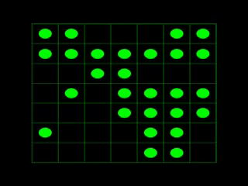
Atom rearrangement - simulation
shot by shot data
digitized
averaged
image
27

Slide 28
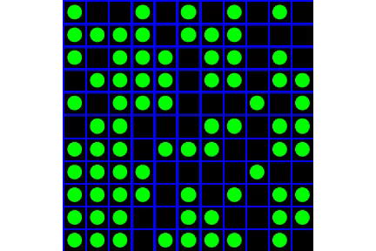
Atom rearrangement - simulation
shot by shot data
digitized
averaged
image
Atom rearrangement
28

